Slide 1
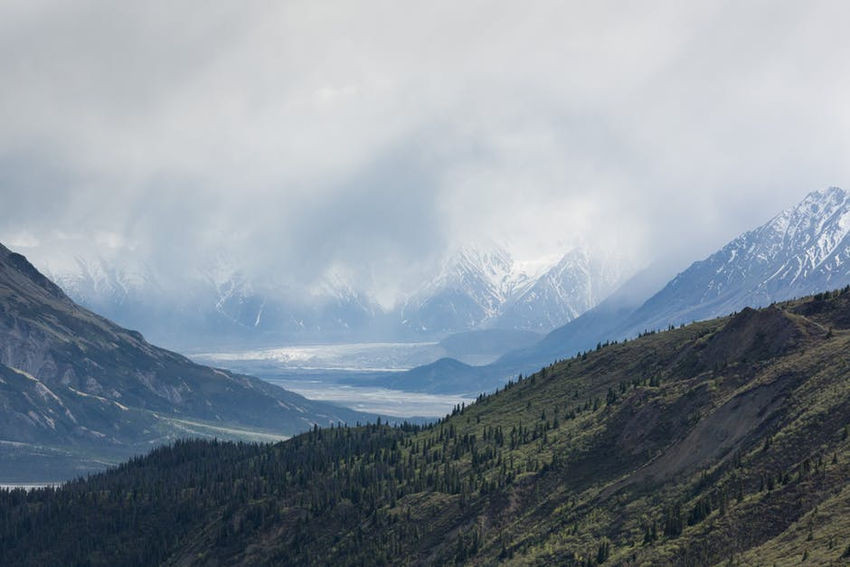
Feed your wanderlust.
BACK
PACKERS

Slide 2
Backpackers
NORTHEASTER UNIVERSITY
INFORMATION SYSTEMS
2018 FALL
AED 5100
MIC
Zhe Xu, Weikai Chen, Zefan Feng

Slide 3
OUTLINE
PROBLEM STATEMENT
APPROACH
OBJECT MODEL
FUNCTIONALITIES
SCREEN SHOTS

Slide 4
Backpackers
Problem
Statement
Stepping in a new era of digital media and market, companies, and customers among most ages, are in separate need of having a one-stop service and management, in terms of traveling…
Airliners & railways: flexibly serve industries and the public
Customers: good deals and transparency

Slide 5
OUTLINE
PROBLEM STATEMENT
APPROACH
OBJECT MODEL
FUNCTIONALITIES
SCREEN SHOTS

Slide 6
Approach
Designed and developed Backpackers:
finds schedule and discount rates and benefits of travel-related purchases for customers.
communication system for contracted third-party companies and administrative operations
Back
Packers

Slide 7
Backpackers
Approaches
Used DB4O (Database for Object) to keep track of the ecosystem of our software
Distributed each role of organizations accordingly into separate packages
Imported and applied multiple libraries/APIs:
Jcalendar
Jfreechart
JavaxMail

Slide 8
OUTLINE
PROBLEM STATEMENT
APPROACH
OBJECT MODEL
FUNCTIONALITIES
SCREEN SHOTS

Slide 9
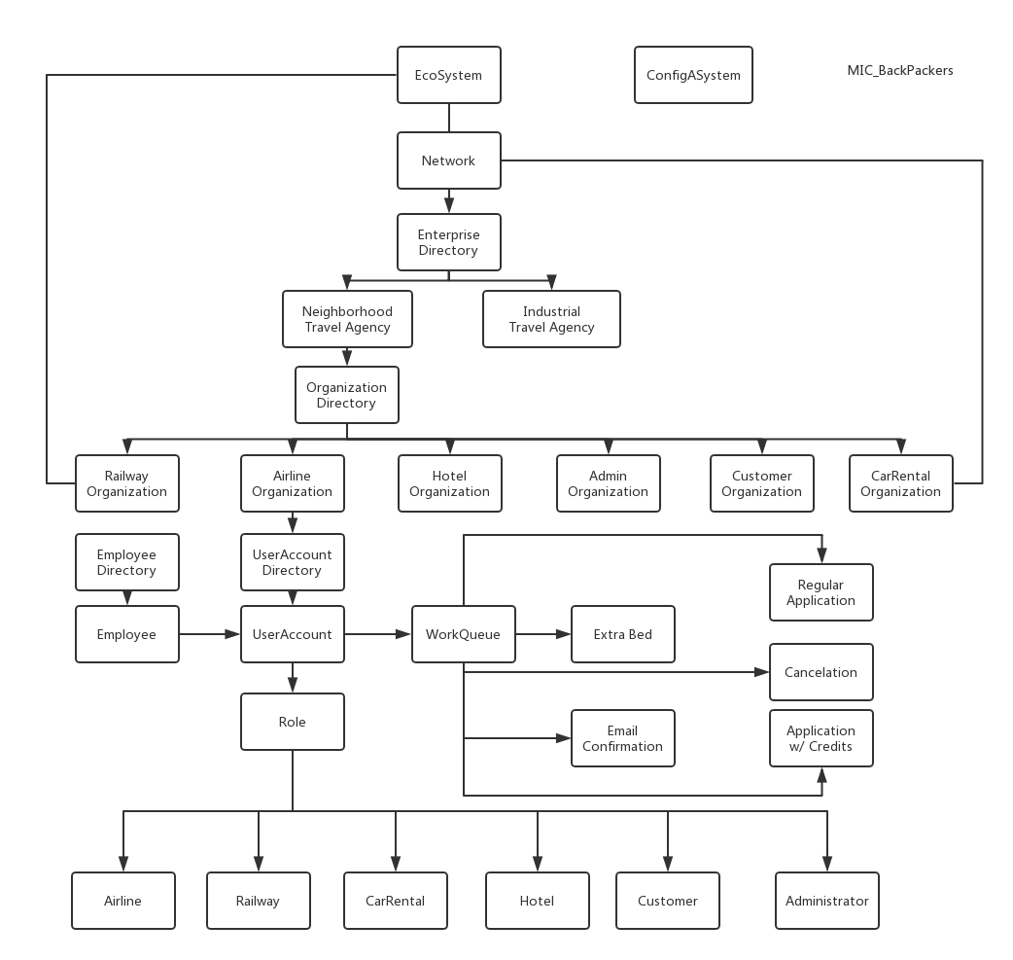
Backpackers

Slide 10
OUTLINE
PROBLEM STATEMENT
APPROACH
OBJECT MODEL
FUNCTIONALITIES
SCREEN SHOTS

Slide 11
Backpackers
Functionalities
FUNCTIONALITY
FUNCTIONALITY
Multi-role
Registration
Login
Information management
Those companies as suppliers, can create, delete and update products/services
FUNCTIONALITY
FUNCTIONALITY
Customers can
search for the trip/stay
keep a record in their account
Administers can
review all orders from various organizations
analyze data based on various criteria.
Work Request & Interaction
Work Request & Interaction
Regular reservation
Reserve benefits w/ credits
Request for cancellation
Provide special service for industrial users
Reserve meeting room in hotel
Reserve business cabin on train
Send E-Ticket confirmation to customers via email

Slide 12
OUTLINE
PROBLEM STATEMENT
APPROACH
OBJECT MODEL
FUNCTIONALITIES
SCREEN SHOTS

Slide 13
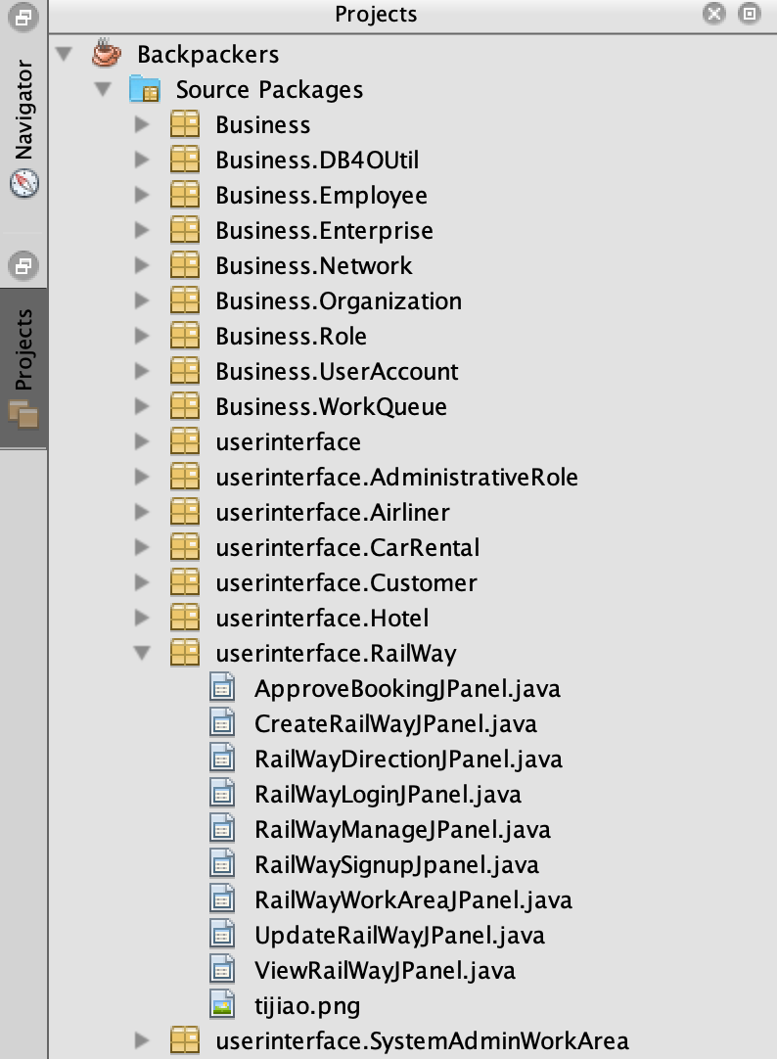
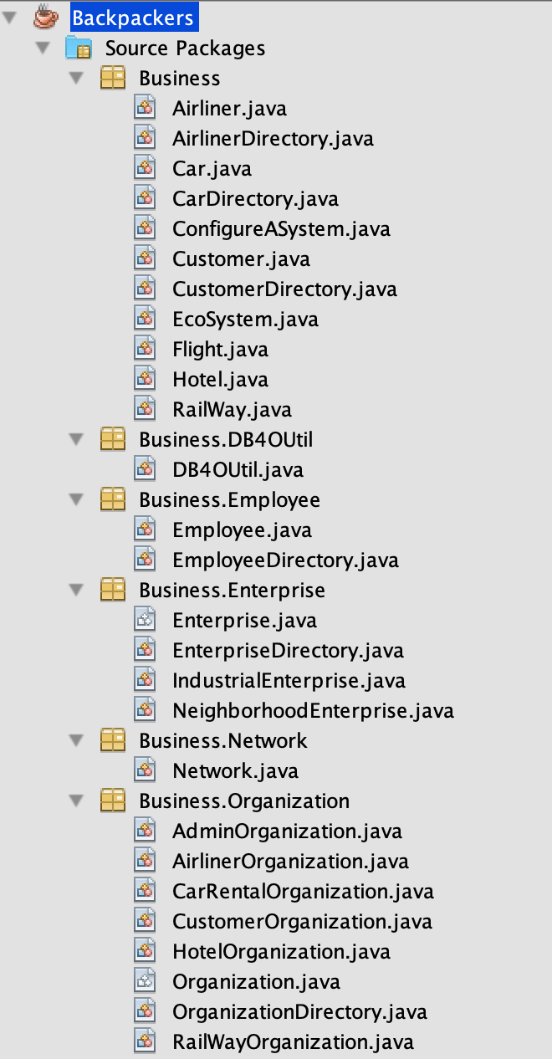
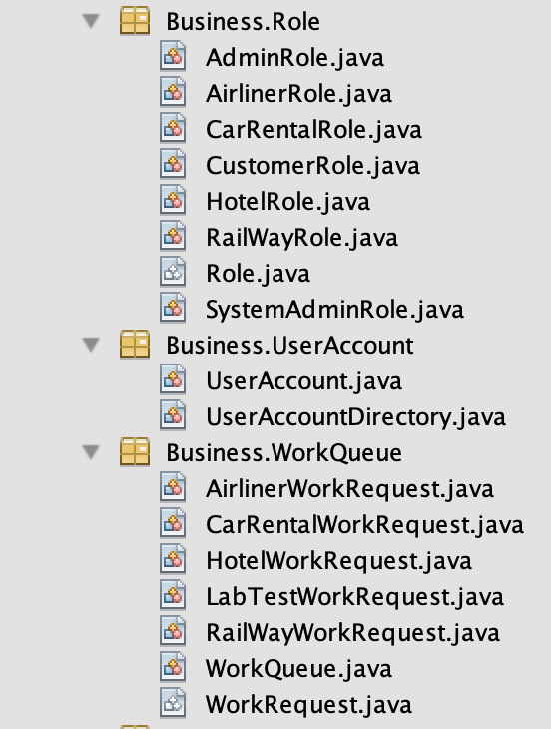
Overall Structure

Slide 14
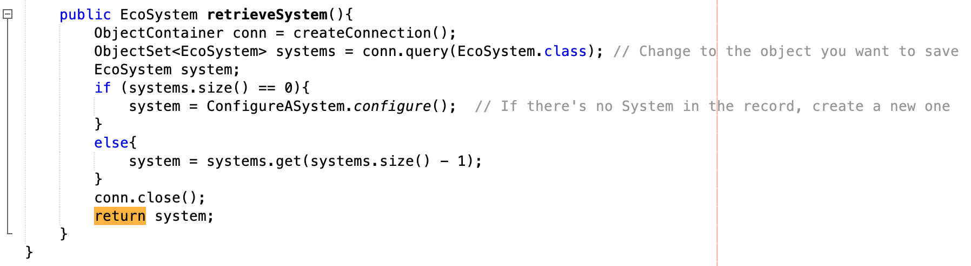
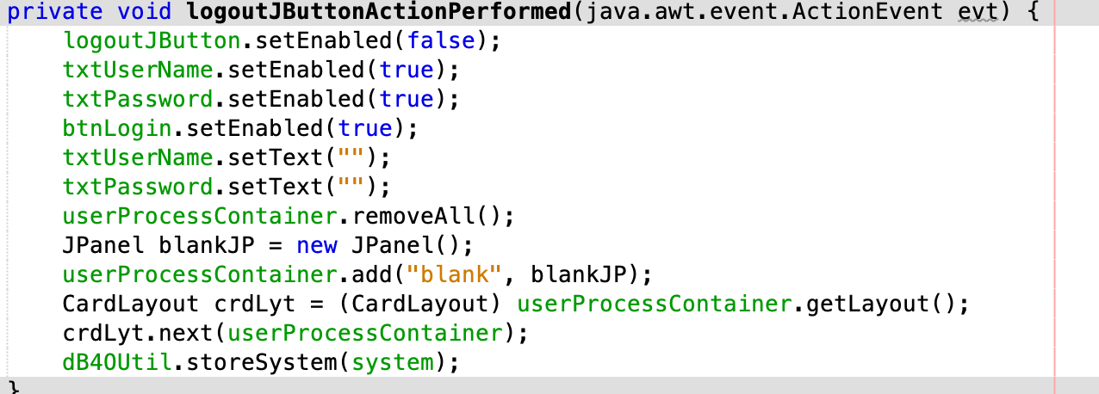
EcoSystem

Slide 15
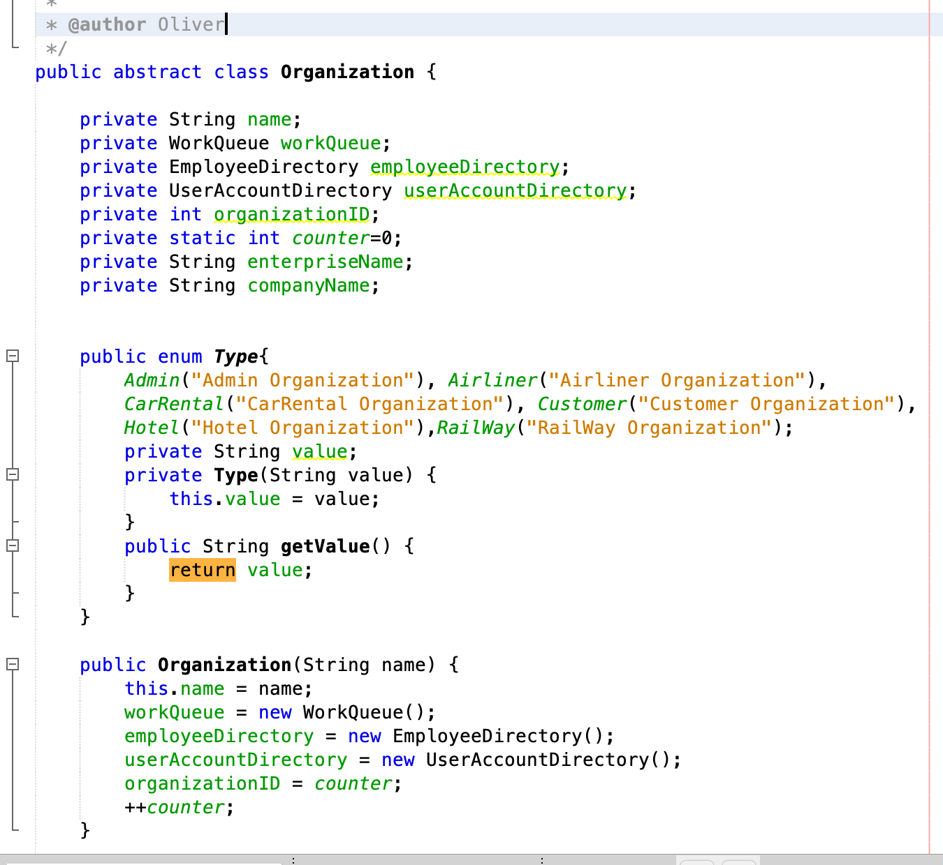
Organization

Slide 16
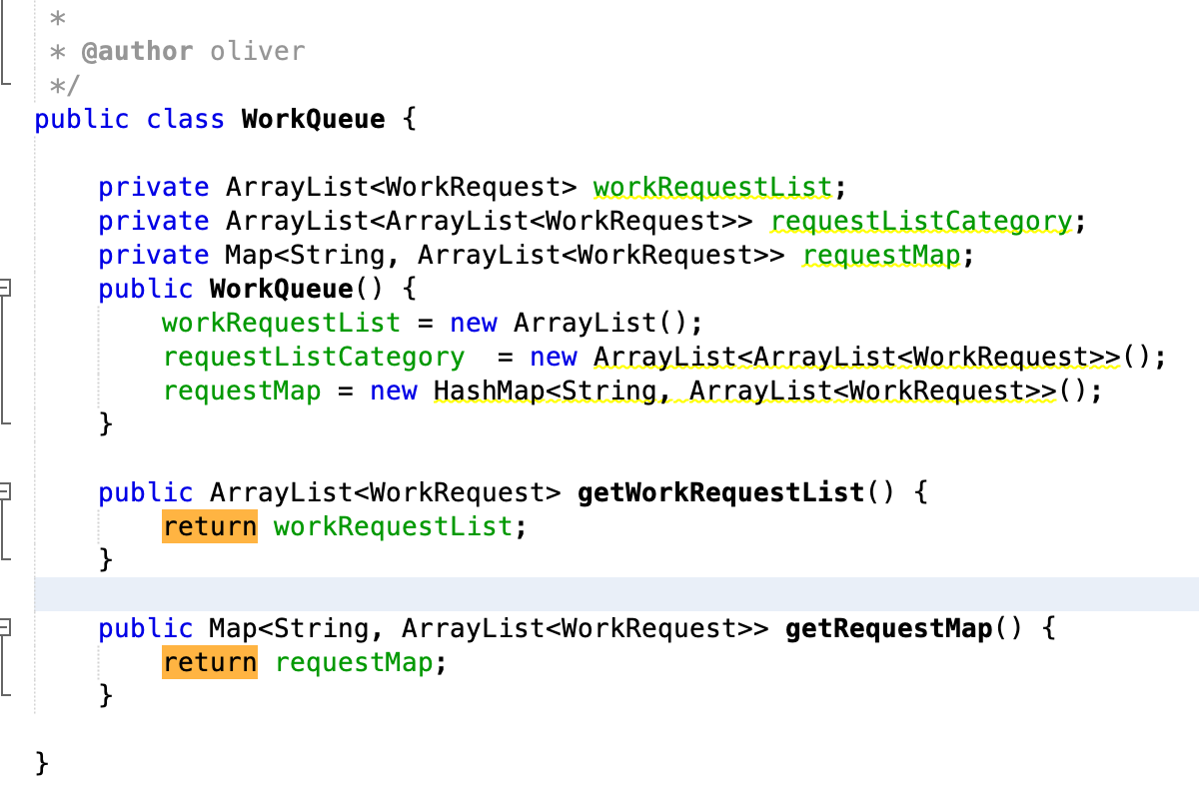
Work Queue

Slide 17
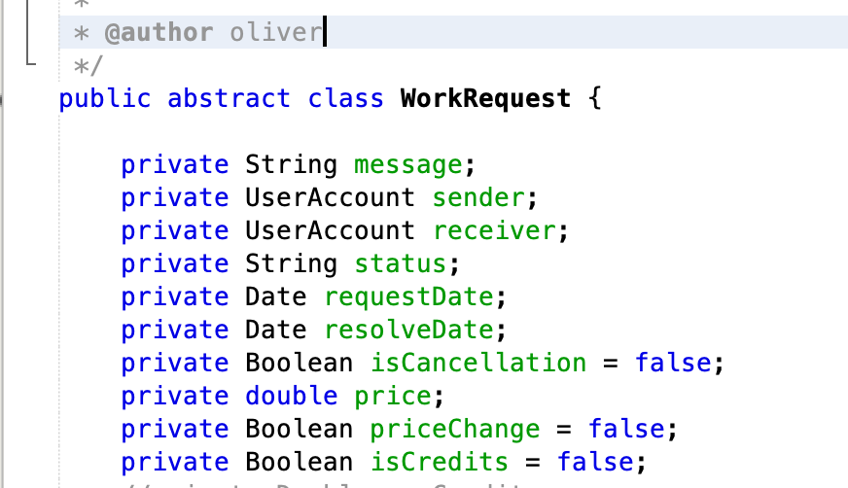
Work Request

Slide 18
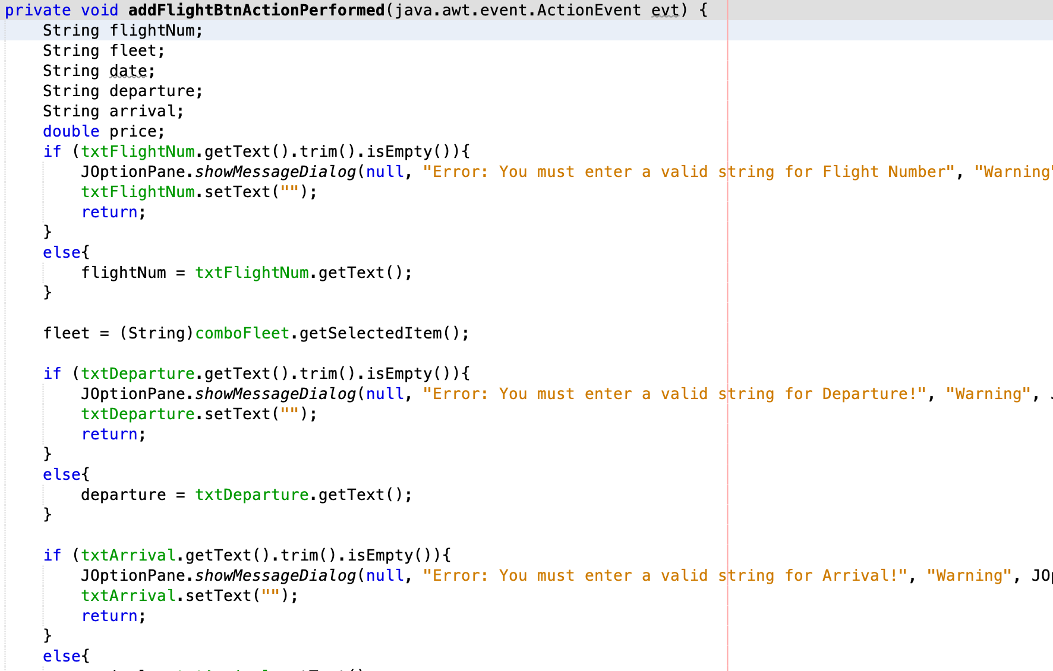
Airliner

Slide 19
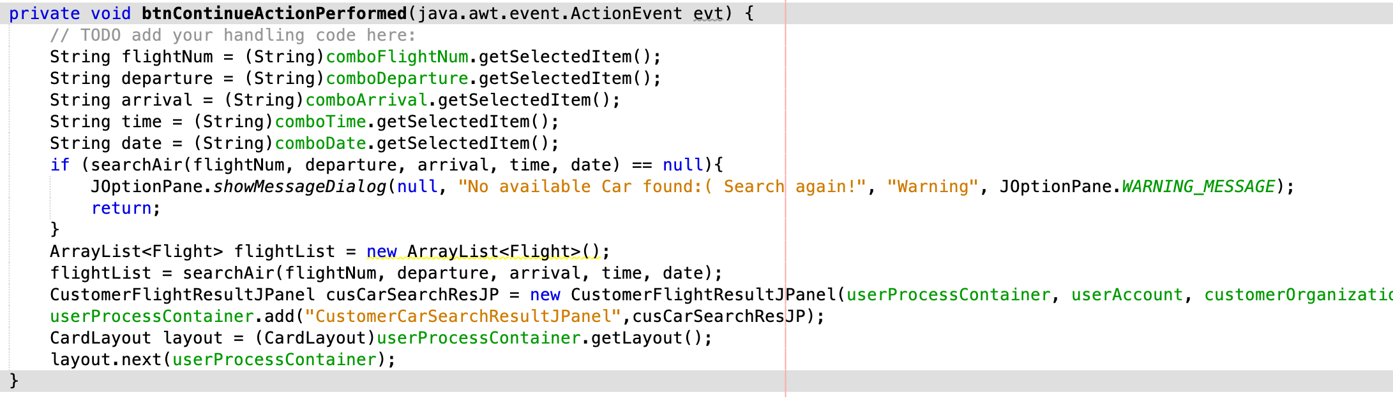
Airliner - Customer
Search Flight

Slide 20
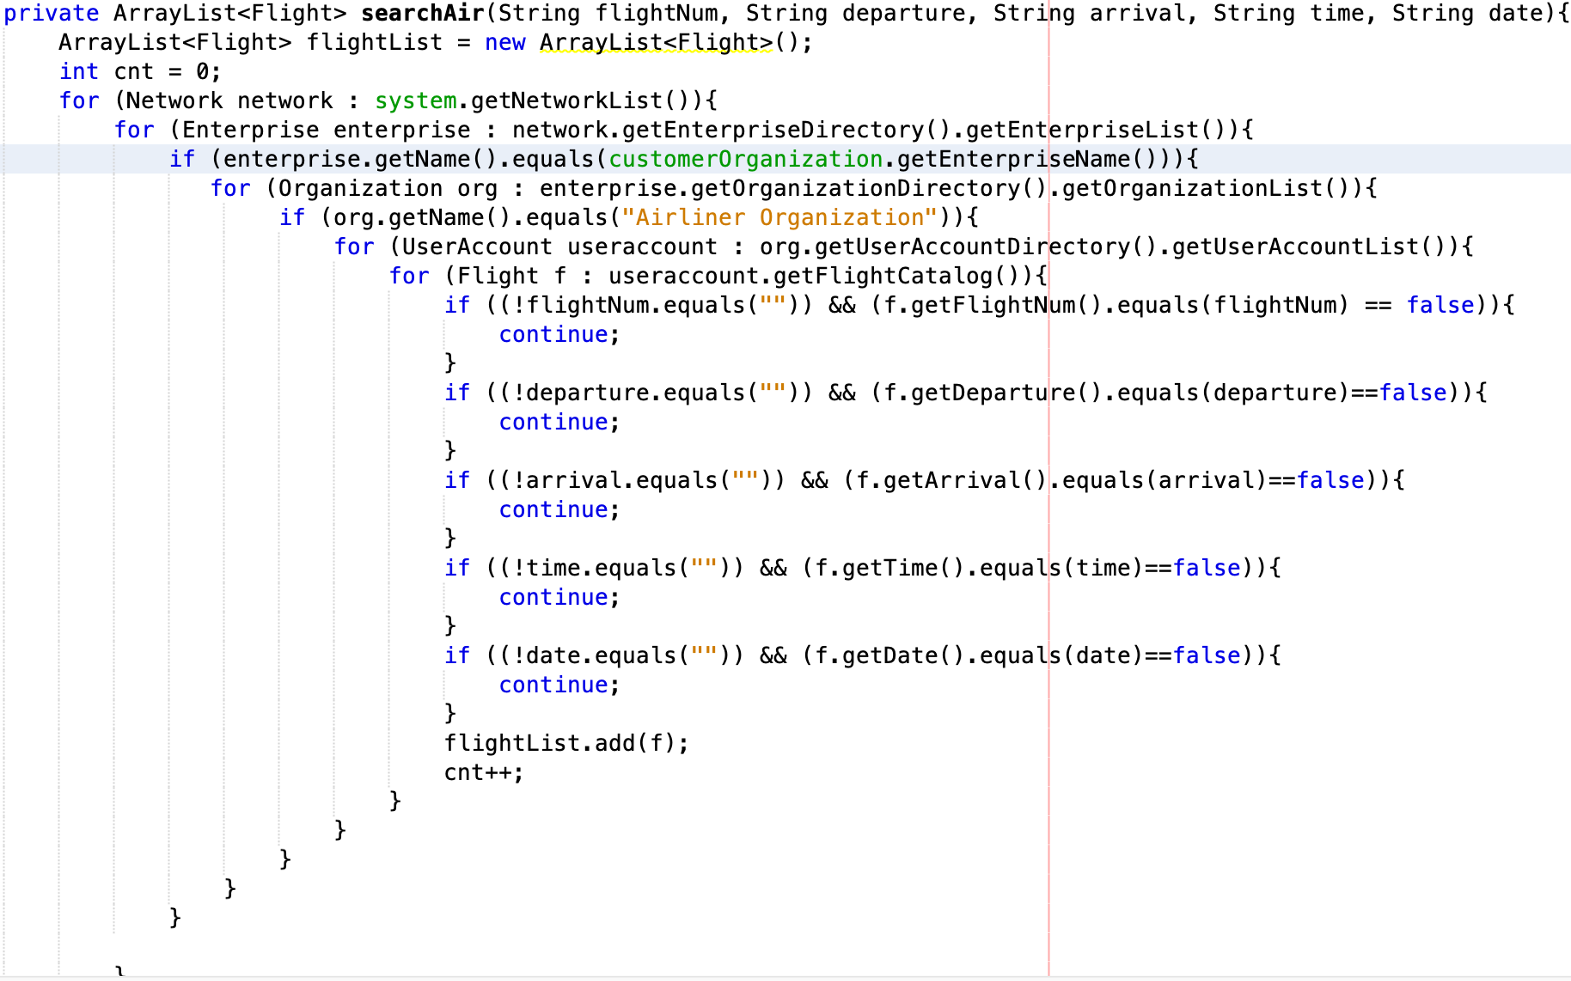
Airliner - Customer
Search Flight

Slide 21
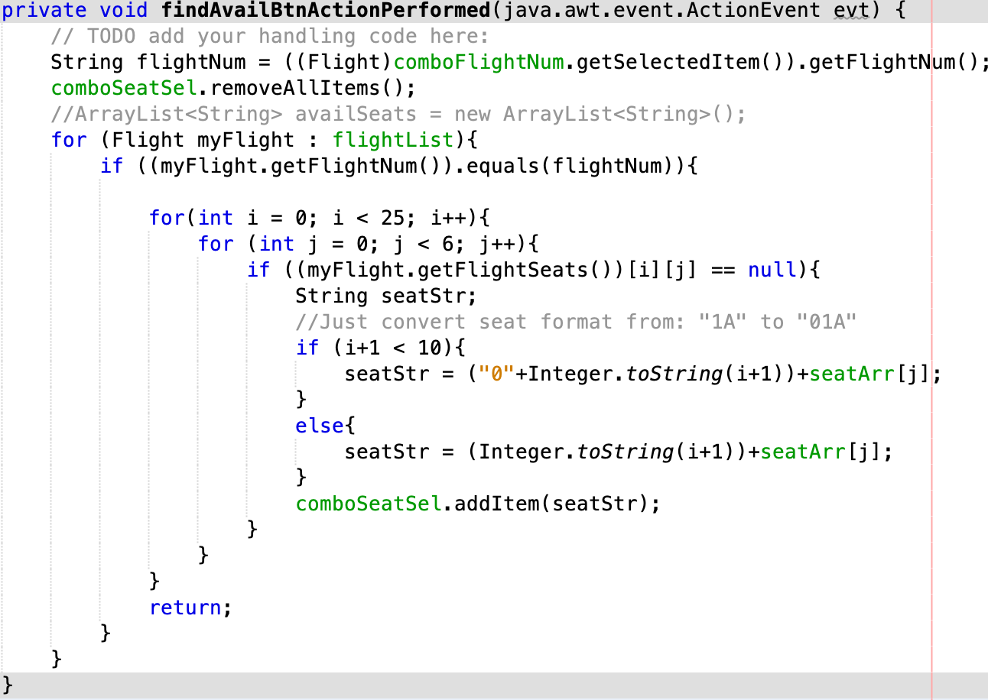
Airliner - Customer
Find available seat

Slide 22
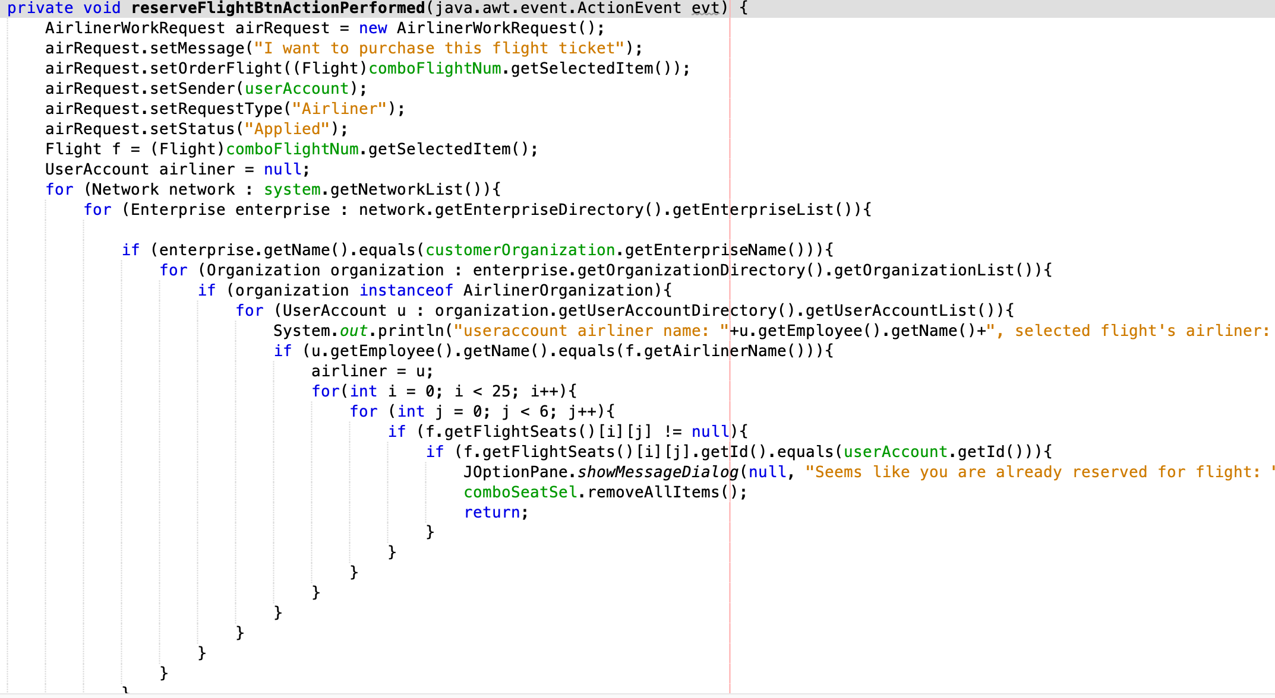
Airliner - Customer
Apply for flight ticket reservation

Slide 23
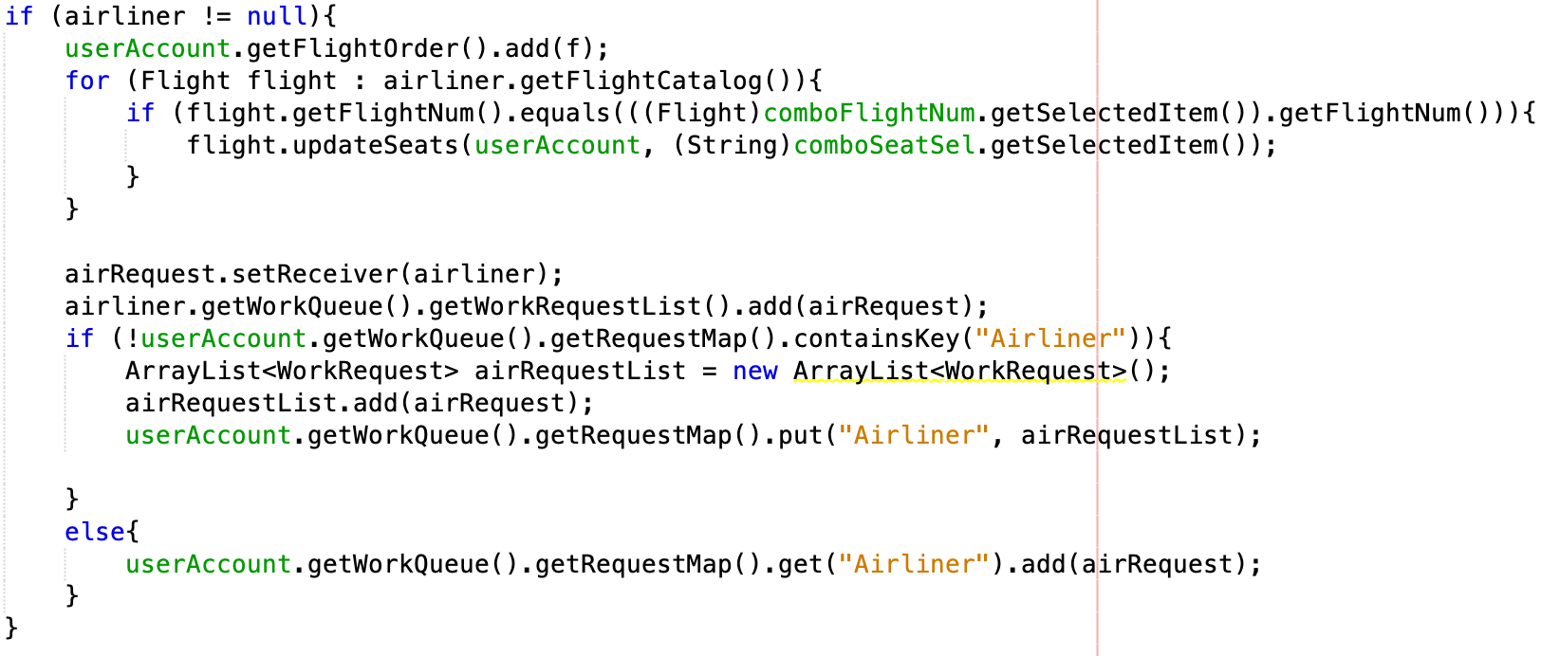
Airliner - Customer
Apply for flight ticket reservation

Slide 24
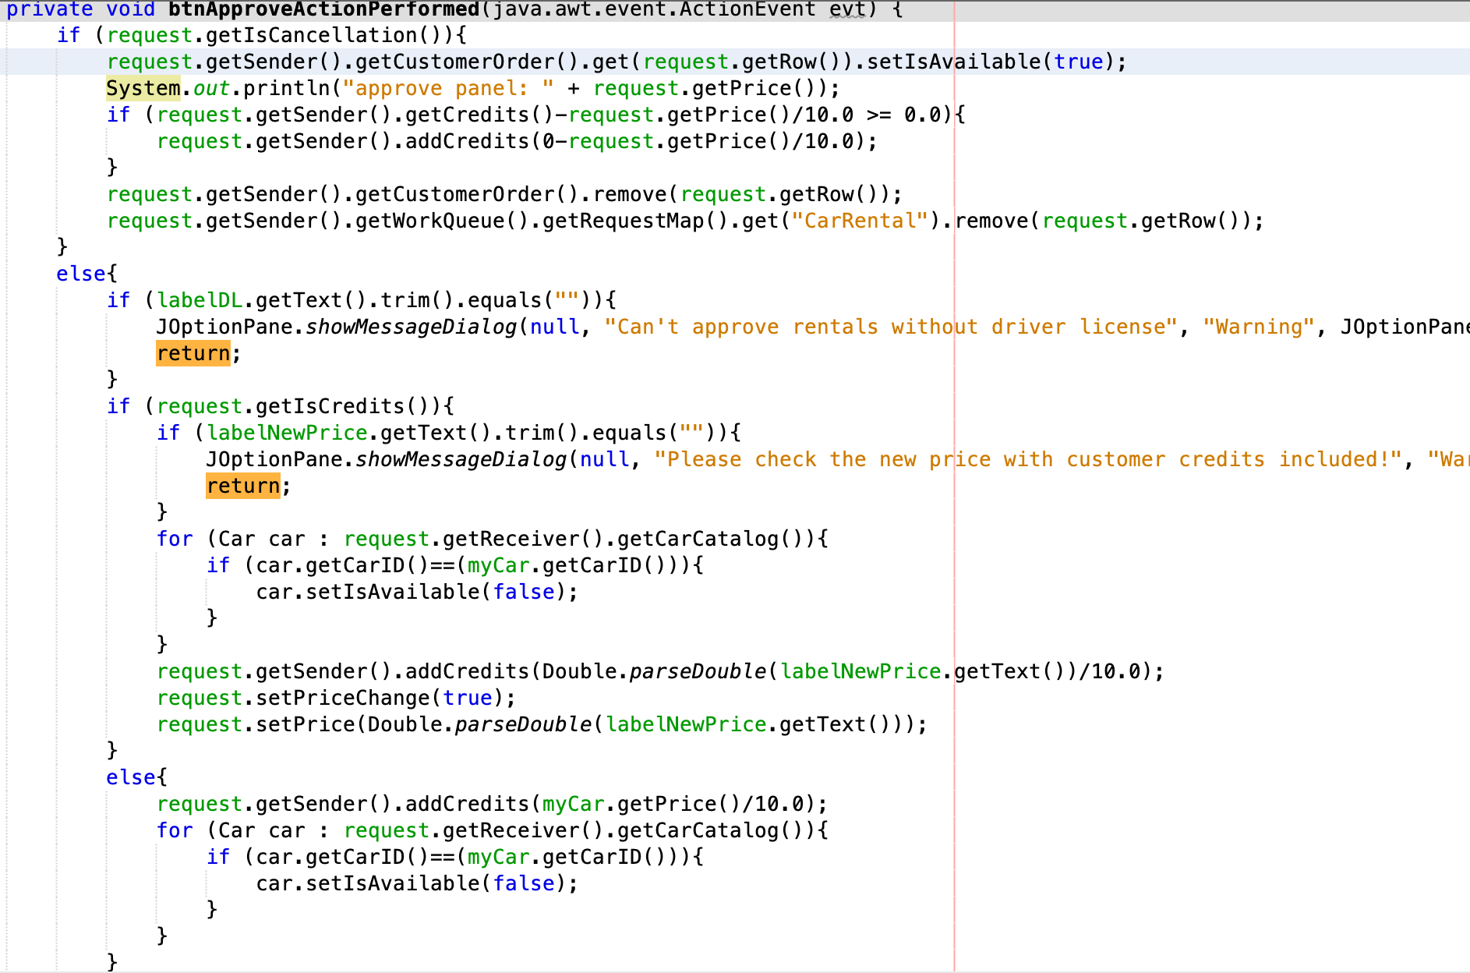
Car Rental Company
Approve Request

Slide 25
Car Rental Company
Decline Request

Slide 26
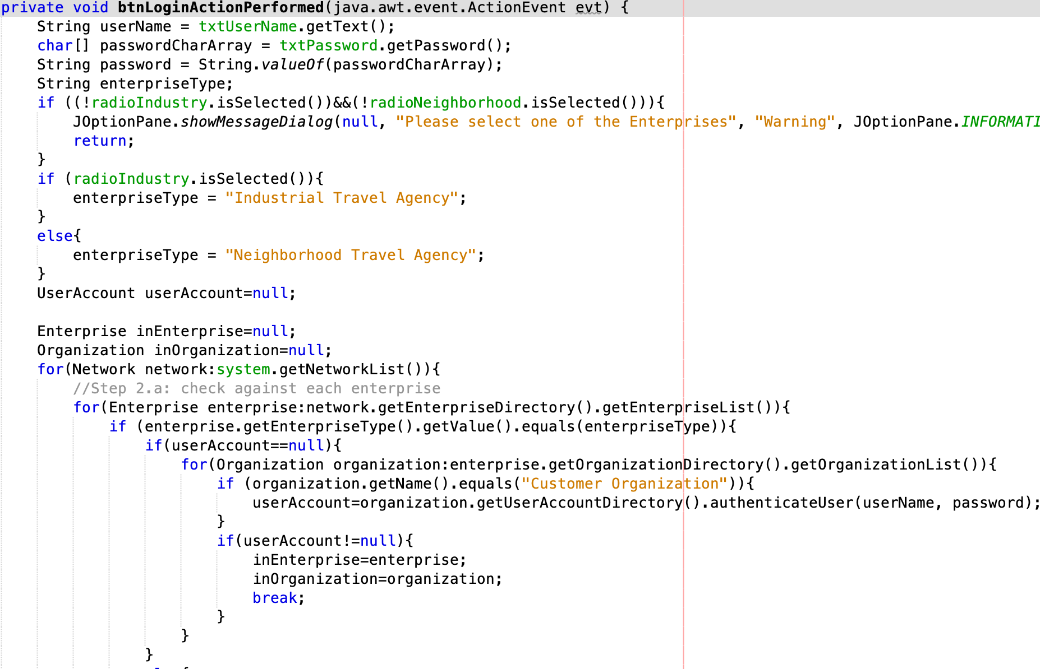
Customer
Login

Slide 27
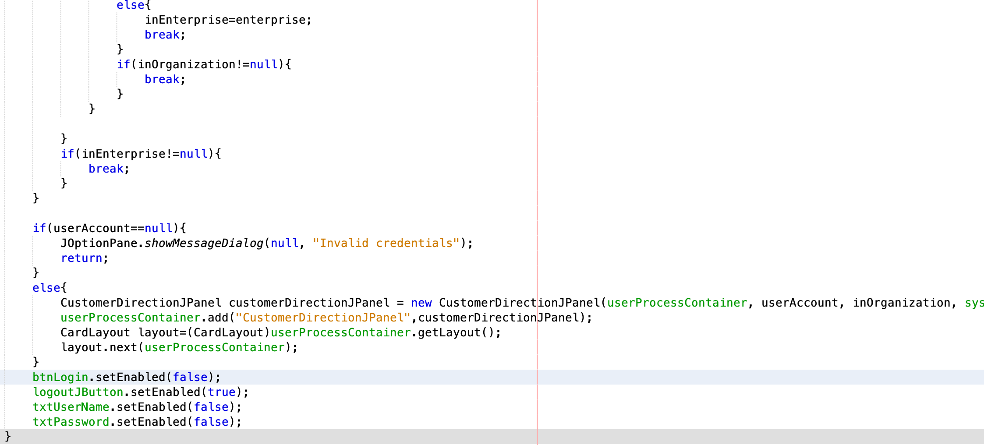
Customer
Login

Slide 28
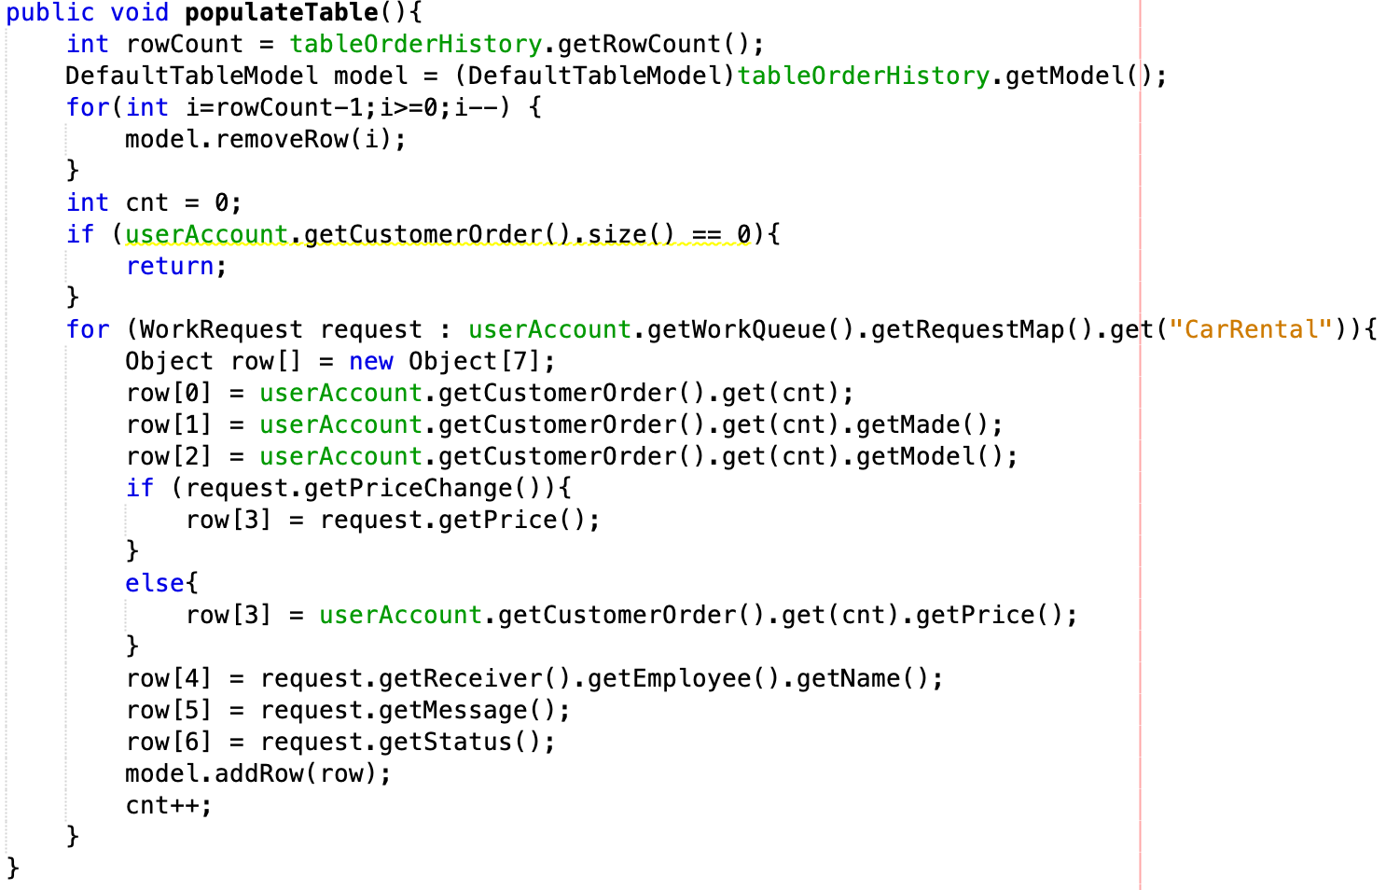
Customer
Order History

Slide 29
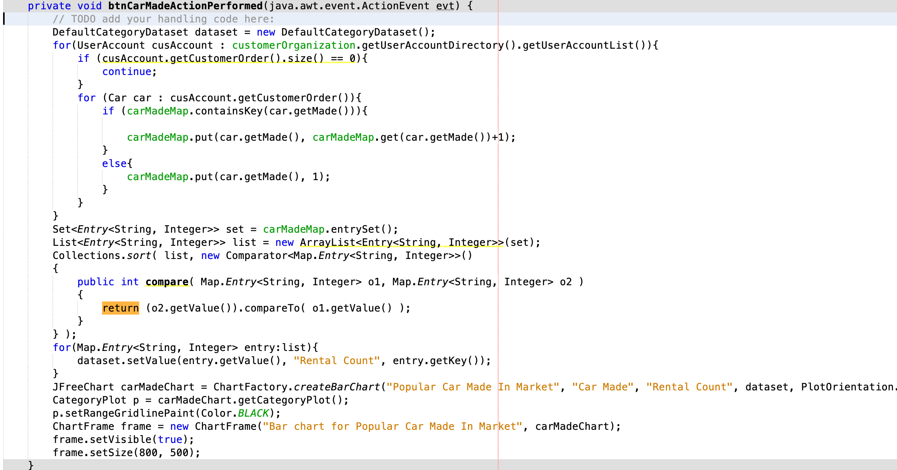
Administrative Role
Order Supervision & Analysis

Slide 30
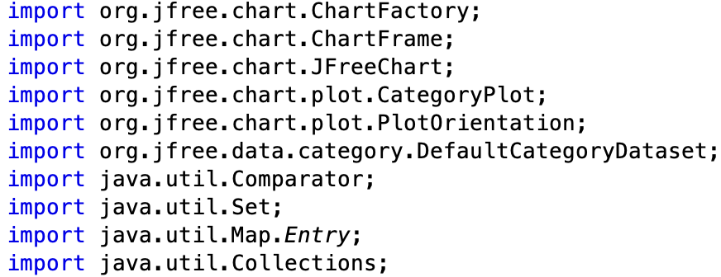
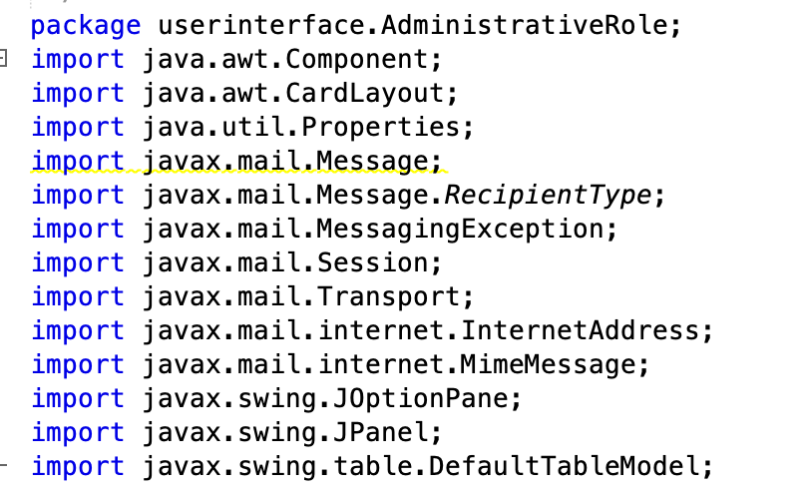
Administrative Role
Order Supervision & Analysis

Slide 31
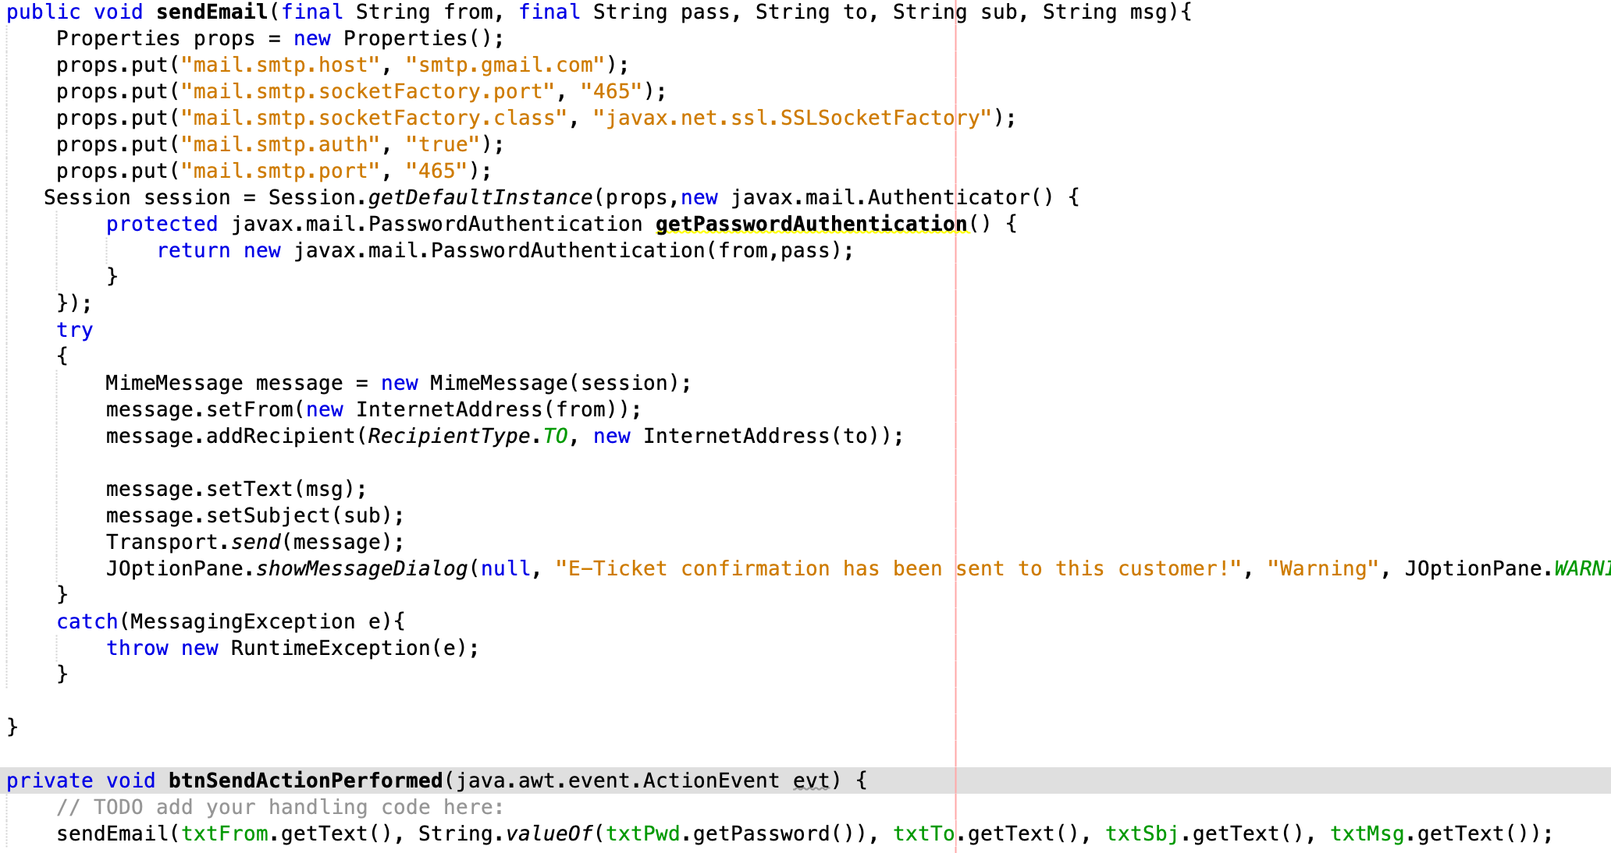
Administrative Role
Order Supervision & Analysis

Slide 32
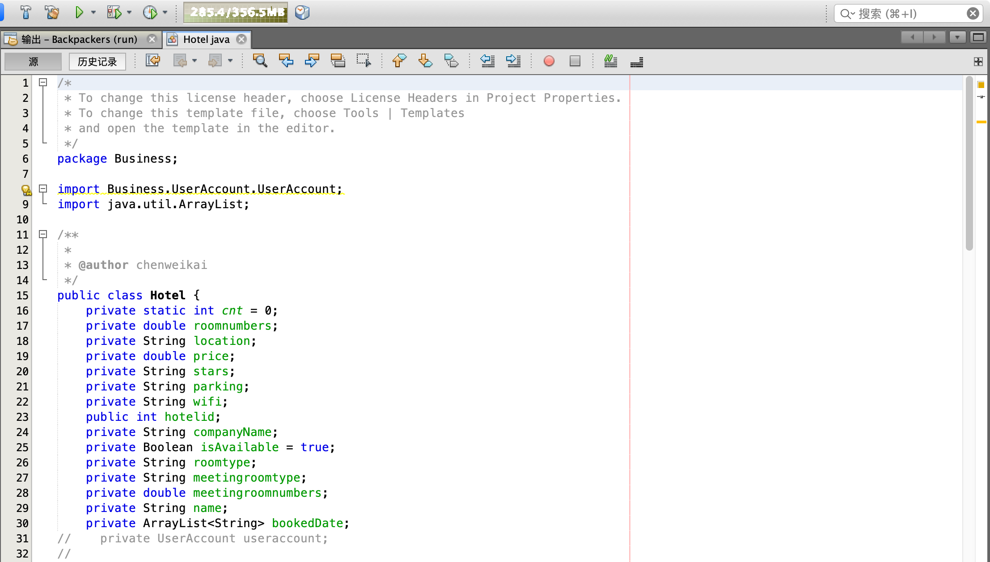
Hotel Properties
Getter and Setter, Store data

Slide 33
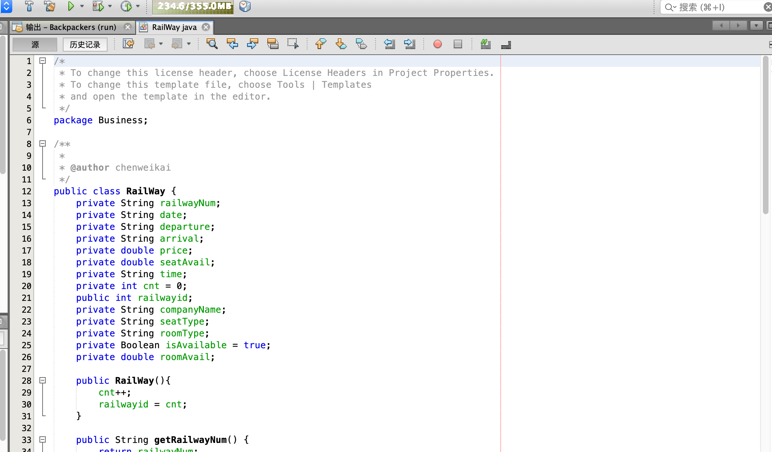
Railway Properties
Getter and Setter, Store data

Slide 34
Search Hotel
Based on location, stars, parking lot and date

Slide 35
Reserve Balcony
Only industry customer can reserve

Slide 36
Backpackers

Slide 37
THANKS FOR YOUR ATTENTION

